Slide 1
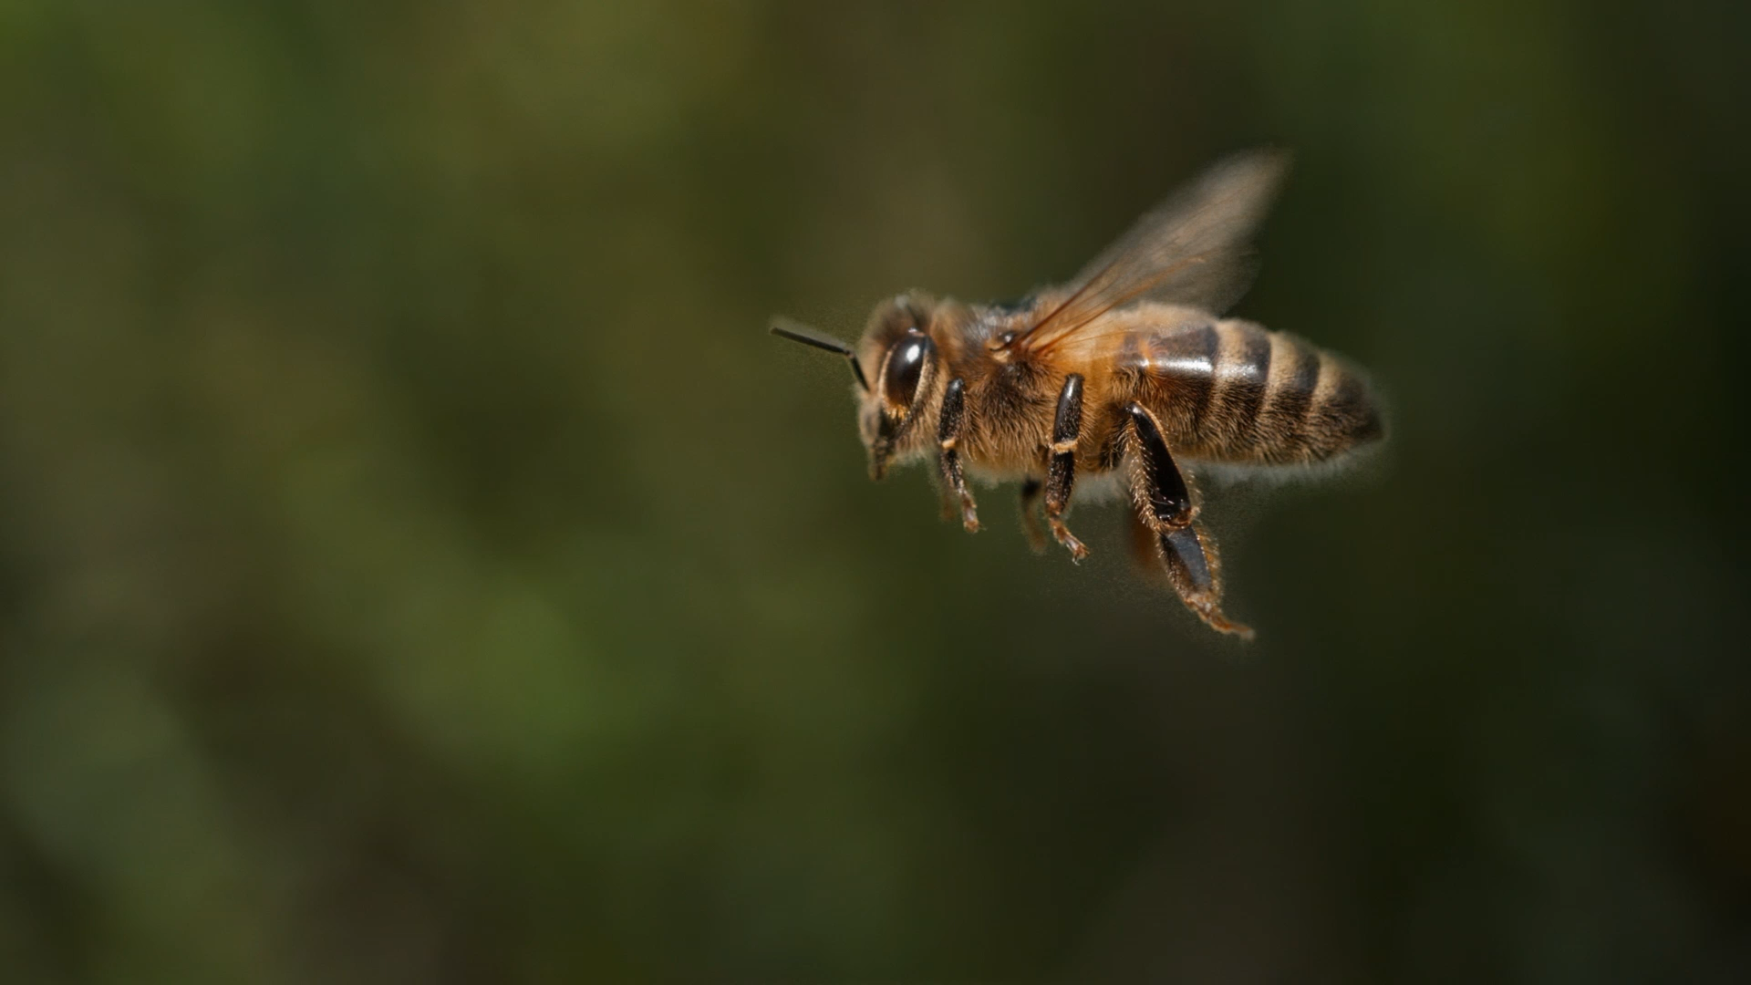
Honeybees’ division of labour
Distributed Artificial Intelligence
UNIMORE – 2024/2025
Andrea Grandi

Slide 2
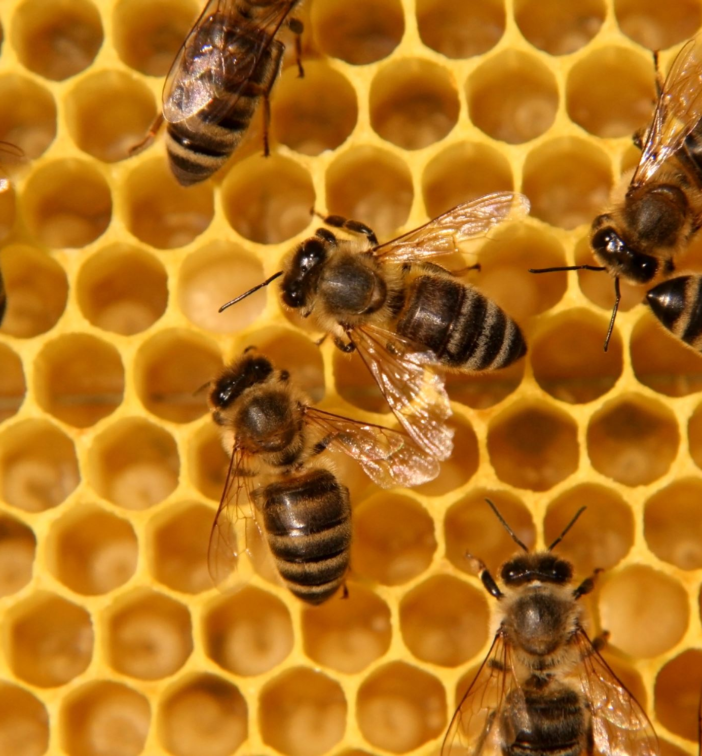
Idea
This work aims to describe and implement the Honeybees’ Division of Labour presented in the paper [1].

